Slide 1
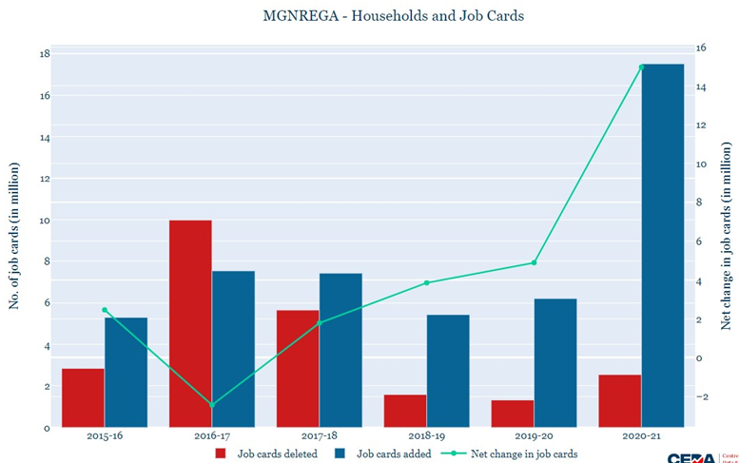
Evaluating the Impact of NREGA on Rural Employment and Poverty
BY
NAME: AKSHAYA.G
BATCH NAME :MIP-DA-09

Slide 2
Agenda
Introduction to NREGA
Effectiveness in Providing Employment
Regional Disparities in Implementation
Budget Utilization and Employment Generation
Factors Contributing to Completion of NREGA Works
Roadblocks to Success
Case Studies
Conclusion and Recommendations

Slide 3
Problem Statement
Key Questions:
How effective is NREGA in providing employment opportunities to rural households?
Are there regional disparities in the implementation and outcomes of the scheme?
What is the utilization of the allocated budget, and how does it correlate with employment generation?
What are the key factors contributing to the completion of NREGA works, and are there any roadblocks to its success?
Can data-driven insights guide policymakers and administrators in optimizing the scheme's impact?

Slide 4

Introduction to NREGA
The Mahatma Gandhi National Rural Employment Guarantee Act (NREGA) was enacted in 2005 to enhance the livelihood security of people in rural areas by guaranteeing 100 days of wage employment in a financial year.
NREGA aims to create durable assets and infrastructure in rural areas, such as roads, canals, ponds, and wells, while addressing the issue of chronic poverty and unemployment.
The program plays a crucial role in providing social protection for the most vulnerable, reducing migration by providing local employment, and empowering rural women by ensuring equal wages for men and women.
Overview and Objectives

Slide 5
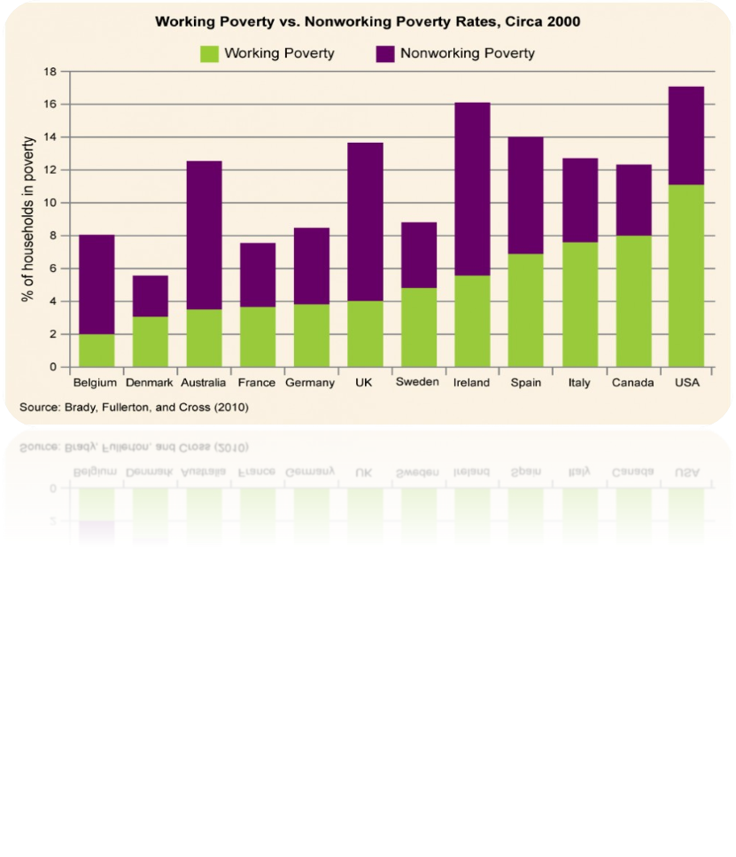
Effectiveness in Providing Employment
65M
2.5B
Households Employed
Person-Days Generated
54%
48B INR
Women Participation
Wages Paid

Slide 6
Regional Disparities in Implementation
Regions with High Success Rates
Regions with Low Success Rates
Kerala: Effective local governance and community participation.
Tamil Nadu: Strong administrative framework and timely wage payments.
Maharashtra: Innovative use of technology for monitoring and transparency.
Bihar: Poor infrastructure and administrative inefficiencies.
Jharkhand: High levels of corruption and mismanagement.
Uttar Pradesh: Delays in wage payments and lack of awareness among beneficiaries.

Slide 7
Budget Utilization and Employment Generation
Budget Allocation
Fund Disbursement
Utilization Monitoring
Employment Generation
The central government allocates funds for NREGA annually based on projected employment demand and previous utilization rates.
Funds are disbursed to state governments and subsequently to local governing bodies to ensure smooth implementation of NREGA projects.
Regular monitoring of fund utilization is conducted to ensure efficient use of resources and to identify any discrepancies or underutilization.
Effective utilization of funds directly correlates with increased employment opportunities. Higher fund utilization rates often result in higher employment generation.
Annual Budget Report
Fund Allocation Plan
State-wise Budget Distribution
State Fund Transfer Reports
Local Body Fund Receipts
Monthly Disbursement Records
Quarterly Utilization Reports
Audit Reports
Utilization Certificates
Employment Generation Reports
Work Completion Certificates
Beneficiary Feedback

Slide 8
Factors Contributing to Completion of NREGA Works
Community Participation
Active involvement of local communities ensures that the projects meet real needs and that there is a sense of ownership, leading to higher completion rates.
Efficient Fund Allocation
Timely and adequate fund allocation by the government helps in the smooth execution of projects, preventing delays and ensuring resources are available to complete the works.
Skilled Workforce
Availability of a skilled and motivated workforce is crucial for the successful completion of NREGA projects, as it ensures quality and timely completion of assigned tasks.

Slide 9
Roadblocks to Success
Administrative Challenges
Corruption
Inefficient processes and delays in approvals hinder timely execution of projects, affecting overall outcomes.
Misuse of funds and fraudulent reporting undermine the integrity and effectiveness of the scheme.
Lack of Resources
Awareness and Accessibility
Insufficient manpower and material resources lead to delays and incomplete projects, reducing the scheme's impact.
Limited awareness among rural households about NREGA rights and provisions restricts participation and benefits.

Slide 10
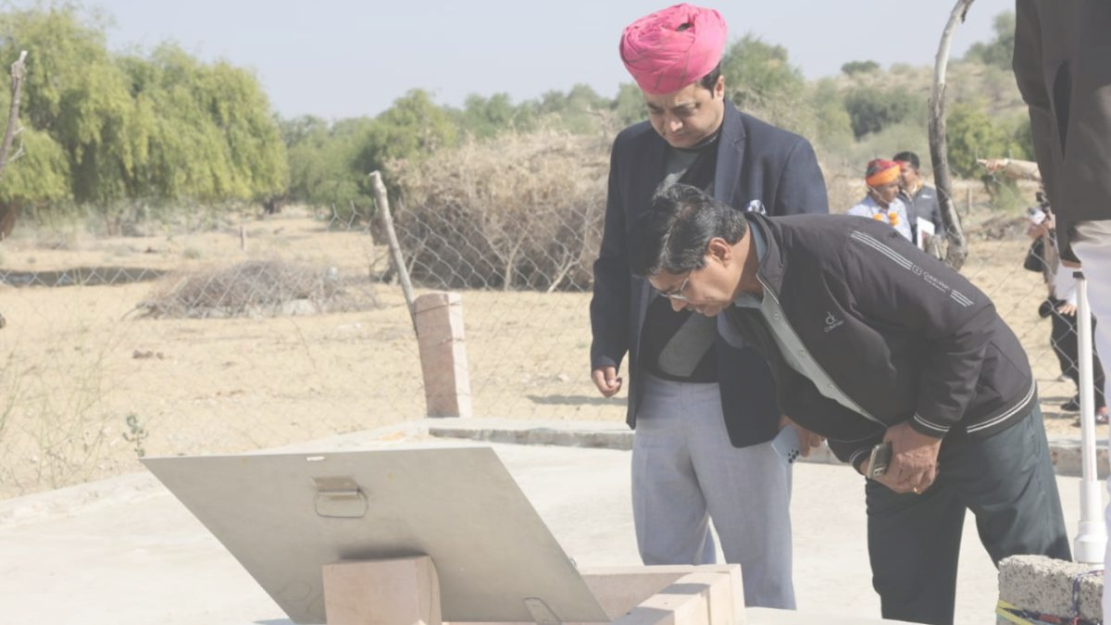
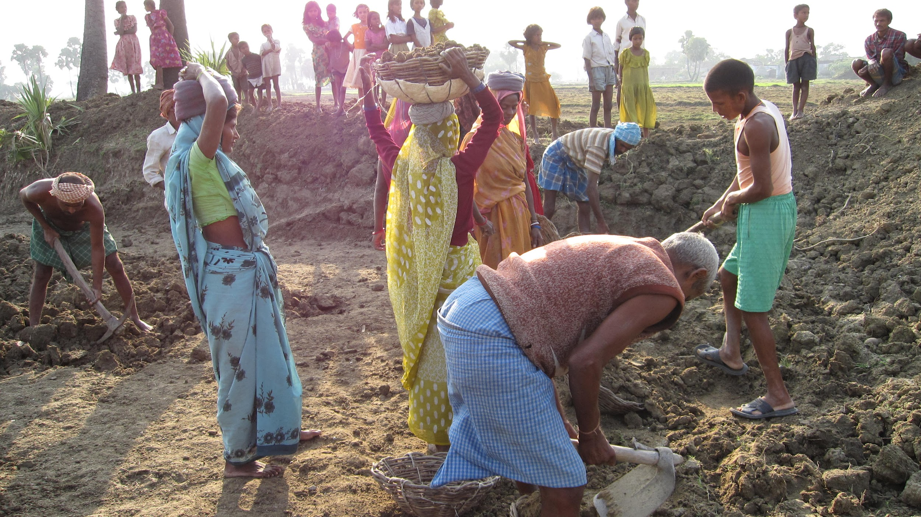
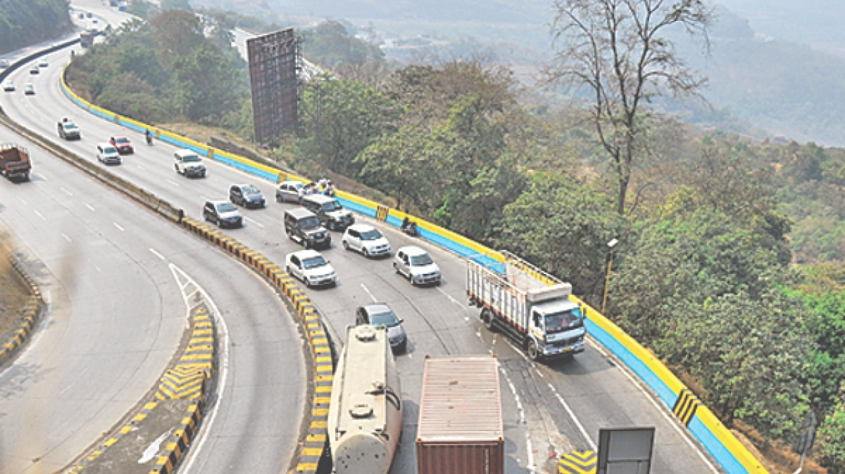
Case Studies
Successful Implementation in Rajasthan
Rajasthan leveraged NREGA for water conservation projects, leading to improved water availability and agricultural productivity.
Challenges in Bihar
Bihar faced issues like delayed payments and corruption, leading to low participation and incomplete projects.
Mixed Outcomes in Maharashtra
In Maharashtra, some districts saw improved rural infrastructure, while others struggled with mismanagement and resource allocation.

Slide 11
Conclusion and Recommendations
The evaluation of NREGA reveals its significant impact on providing employment opportunities and alleviating rural poverty. However, regional disparities and budget utilization issues persist. To enhance NREGA's effectiveness, it is crucial to ensure equitable implementation across regions, improve transparency in budget utilization, and streamline administrative processes. Additionally, addressing corruption and enhancing local governance can further support the successful completion of projects. By focusing on these areas, NREGA can better achieve its objectives and provide sustainable employment for rural households.

Slide 12
Thank you.

